Slide 1
PROJECT TITLE
PIP104 PROFESSIONAL PRACTICE-II
VIVA-VOCE
Batch Number: CSE-G151
Roll Number | Student Name
202021CSE0811 | Prashanth B
20201CSEO800 | Raghavendra
20201CSE0813 | Sachin k Nayaka
20201CSE0781 | P john
20201CSE0827 | Raghavendra
Under the Supervision of,
Dr. Pamela Vinitha Eric
Professor
School of Computer Science Engineering & Information Science
Presidency University

Slide 2
Introduction
For any vehicle accidents driver’s faults are the most accountable aspect to cause dangerous problem to the society. Many drivers cannot control the vehicles due to different reasons it may cause severe accidents and sometime death.
For vehicle accidents various factors involved such as drunk driving, over speeding, many distractions like texting while driving, talking with others, playing with children etc. one of the important factor is sleeping on the wheel.

Slide 3
Introduction
People know the dangerous of alcohol consumption and run the vehicles but they not understand the seriousness of fatigue driving. In India, Ministry of Road Transport and Highway released a report in 2015, every day around 1,374 accidents may happen and almost 400 people deaths occur. Every hour because of vehicle accidents approximately 57 road accidents and 17 people dies.
In that 54.1 percent of people are in the age group of 15 to 34 years are killed in vehicle accident. The Government of India, Ministry of Road Transport and Highway Government of India prepare a strategy to diminish the amount of motorway accidents and losses by 50 % by 2020. Globally vehicle accidents have seemed one of the major community health problems. In India almost 5 lakh road accidents happened in the year 2015.

Slide 4
Introduction
Driver drowsiness detection is a car safety technology which helps prevent accidents caused by the driver getting drowsy. Various studies have suggested that around 20% of all road accidents are fatigue-related, up to 50% on certain roads.
The drowsiness detection system is capable of detecting drowsiness quickly
A deep learning Architecture detects the face and eyes, based on the status of the eyes. If the eyes are closed more than usual time, it generates an alarm, intimating the driver

Slide 5
Literature Review
In recent years, the drowsiness of the driver is detected by using image processing techniques. If the drivers eyes closed for certain period of time, the driver is said to be drowsy.
As a result we get information related to driver’s condition and the speed of the car is reduced. Rate of death due to road accidents is increasing day by day.
If somehow collision occurs it will detect collision using impact sensor and provide emergency help service for driver. The alcohol sends a value of alcohol contained in the drivers breathe in case of consumption and indicates the values in LCD display and sends message to the registered phone number

Slide 6
Research Gaps Identified
Research Gap - Real-time Drowsiness Detection
Need for Real-time Detection:
Real-time drowsiness detection is imperative to identify signs of fatigue promptly during driving.
Timely intervention can prevent potential accidents by alerting the driver or triggering safety measures before critical situations arise.
Consequences of Delayed or Inaccurate Drowsiness Detection:
Increased Risk of Accidents
Compromised Driver and Passenger Safety
Reduced System Reliability

Slide 7
Research Gaps Identified
2) Alcohol Detection: Driving under the influence of alcohol refers to operating a vehicle while impaired by the consumption of alcoholic beverages. This dangerous behavior significantly compromises road safety due to the impact of alcohol on cognitive functions and motor skills. Alcohol impairs judgment, coordination, and reaction times, leading to an increased risk of accidents.
Research Gap - Continuous Alcohol Monitoring
Research Gap - Continuous Alcohol Monitoring:
Inaccuracy in Real-time Assessment
Risk of Missing Peak Intoxication Moments
Shortcomings in Detecting Gradual Changes:

Slide 8
Research Gaps Identified
3) Crash Detection: It is the process of identifying and recognizing the occurrence of a vehicular collision or impact
Impact of Crashes on Road Safety: Crashes pose a significant threat to road safety, leading to injuries, fatalities, and property damage.
Current Methods for Crash Detection in Vehicles: Vehicle-based technologies such as accelerometers and collision sensors are commonly used for crash detection.
Research Gap - Enhanced Crash Detection Algorithms:
Advanced Algorithmic Enhancement
Integration of Machine Learning

Slide 9
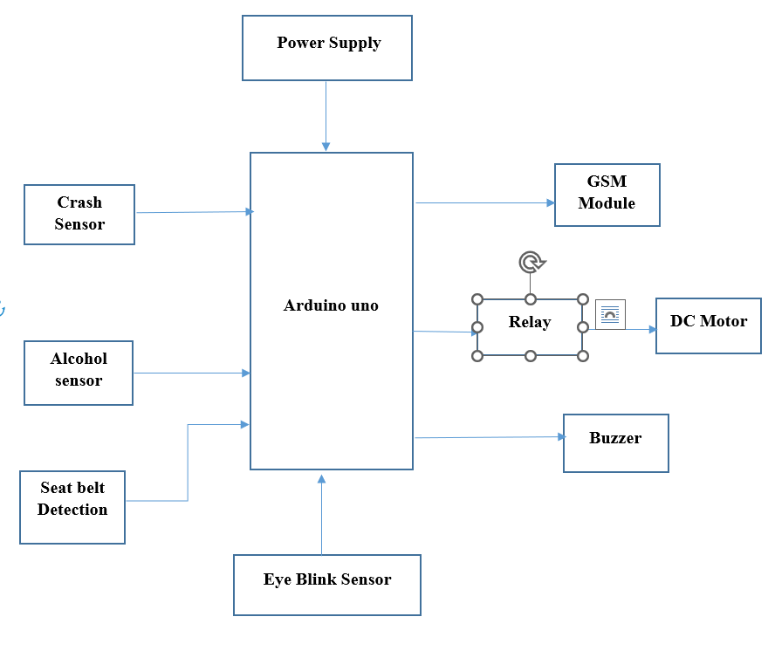
Proposed Methodology

Slide 10
Objectives
Objectives of the Driver Drowsiness Detection System:
Enhance Road Safety
Implement Robust Power Management
Early Collision Detection
Arduino Nano Integration
Eye Blink Monitoring
Alcohol Detection
Seat Belt Usage Monitoring
Visual Feedback through LCD Display

Slide 11
System Design & Implementation
The system designs to find the drivers drowsiness using the hypothesis of Bayesian networks. The interaction between driver and vehicle features are extracted to get reliable symptoms of driver drowsiness.
The implementation of the Driver Drowsiness and Alcohol Detection System is poised to be a game-changer in the realm of road safety. By addressing both drowsiness and alcohol consumption, the system is anticipated to significantly reduce accidents caused by impaired driving.
Proactive intervention mechanisms, such as slowing down the car's motor and activating a buzzer, serve as crucial safeguards, preventing potential collisions and ultimately saving lives.
Beyond accident reduction, the system promotes a culture of responsible driving habits by providing real-time monitoring of alcohol levels and blink rates. This heightened awareness encourages drivers to prioritize their well-being and fosters a safer driving experience.

Slide 12
Outcomes / Results Obtained
Outcomes
The implementation of the Driver Drowsiness and Alcohol Detection System is poised to be a game-changer in the realm of road safety. By addressing both drowsiness and alcohol consumption, the system is anticipated to significantly reduce accidents caused by impaired driving.
Proactive intervention mechanisms, such as slowing down the car's motor and activating a buzzer, serve as crucial safeguards, preventing potential collisions and ultimately saving lives.
Beyond accident reduction, the system promotes a culture of responsible driving habits by providing real-time monitoring of alcohol levels and blink rates. This heightened awareness encourages drivers to prioritize their well-being and fosters a safer driving experience.
Moreover, the expected outcomes extend to broader societal impacts and technological advancements. The system aligns with global road safety initiatives by becoming a catalyst for continued innovation in automotive safety.

Slide 13
Outcomes / Results Obtained
Outcomes
As a pioneer in integrating advanced sensor technologies and real-time monitoring capabilities, the system sets a precedent for future safety features in vehicles.
Its user-friendly interface, featuring an informative display through the Arduino IDE's serial monitor, adds a layer of transparency and self-awareness for drivers.
The scalability and adaptability of the system position it as a versatile solution that can be seamlessly integrated into various vehicle models, showcasing its potential to transform the landscape of automotive safety standards on a global scale.

Slide 14
Conclusion
The driver drowsiness and alcohol detection system is used to detect the drowsiness of the driver and also detects the alcohol consumption of driver.
The proposed system helpful to avoid vehicle accidents because of driver’s sleepiness using eye blink sensor, in this paper we study 504 International Journal of Engineering & Technology and design the system for driver fatigue detection.
If the driver becomes drowsy the eye blink sensor’s frame vibrates attached to the vehicle and also the LCD displays the warning messages and it alerts the driver’s through alarm sound to avoid the road accidents. The wheel is slowed or stopped depending on the condition.
If there is drowsiness or consumption then the motor of the car gets slowed down and the buzzer sounds until the eyes gets opened.
The values of alcohol and the blink rate will be displayed in the serial monitor of the Arduino IDE. This proposed system helps in finding drowsiness and alcohol detection using Arduino. This helps in avoiding many accidents. Further we extend this project by using webcam to detect the drowsiness of the driver.

Slide 15
References
[1] Elzohairy Y (2008) Fatal and injury fatigue-related crashes on ontario’s roads: a 5-year review. In: Working together to understand driver fatigue: report on symposium proceedings, february 2008
[2] Dingus TA, Jahns SK, Horowitz AD, Knipling R (1998) Human factors design issues for crash avoidance systems. In: Barfield W, Dingus TA (eds) Human factors in intelligent transportation systems. Lawrence Associates, Mahwah, pp 55–93.
[3] Idrees, H., Warner, N., and Shah, M. (2014). Tracking In Dense Crowds Using Prominence And Neighborhood Motion Concurrence. Image And Vision Computing, 32(1):14–26. Yamamomo K, Higuchi, S Development of a drowsiness warning system. J, SocAutomotEng Jap 46:127–133 Archana Jenis M.R M.E. International Journal of Science, Engineering and Technology, 2020.
[4] Ueno H., Kanda, M. and Tsukino, M. “Development of Drowsiness Detection System”, IEEE Vehicle Navigation and Information Systems Conference Proceedings, (2015), ppA1-3,15-20.
[5] Sean Enright, Electronics Engineering Student, 506- 650-3611, May 26-2017, Alcohol Gas Detector “Breathalyzer”.

Slide 16
Publication Details

Slide 17

Thank You

